Slide 1
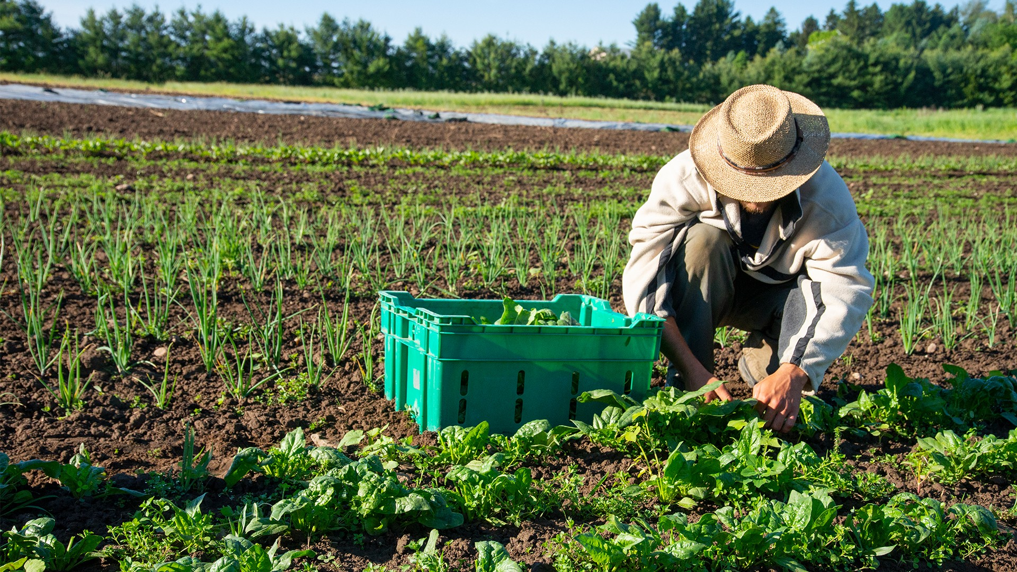

Recruiting 101:
What all new Recruiters Should Know
Justyn Settles
IDRC Project Specialist
859-361-2239- cell
justynidr@gmail.com
www.idr-consortium.net

Slide 2
Agenda:
Recruiting is a fast paced job. New recruiters are often asked to learn quickly and adapt on the fly to circumstances they encounter in the field. This training is a crash course on what it means to be a recruiter. We will cover what it means to be a recruiter, what expectations they should have about working in the field, and helpful tips to get them ready for success as quickly as possible!

Slide 3
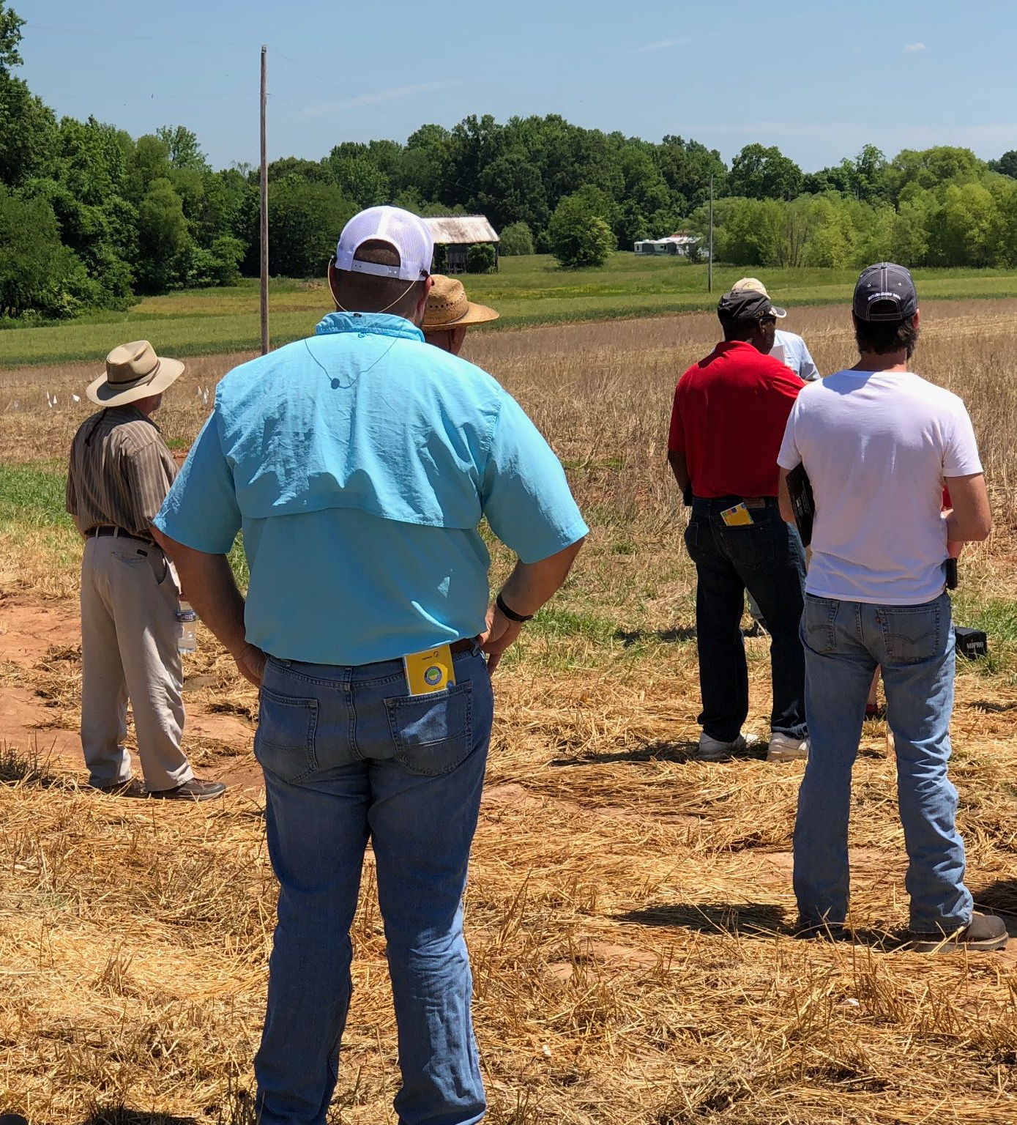
What is a recruiter?
Recruiters are an integral part of the Migrant Education Program. Recruiters are the face of the program. They are the first ones that many migrant farmworkers and students meet before being enrolled in MEP.
Recruiters are the eyes and ears of the Migrant Education Program as they search through their communities to find the families and students who are eligible for MEP services.

Slide 4
What is a recruiter?
The role of the recruiter is to identify and enroll ALL Migrant students across their assigned area in a timely manner and to provide initial services to students.

Slide 5
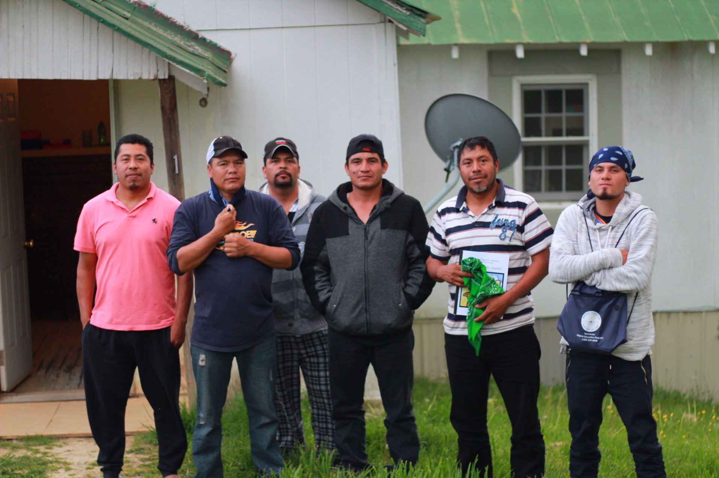
How do Recruiters Find Families
Recruiters use all available information and resources in our disposable to find leads to follow up on, conduct verbal interviews with families, and make decisions on eligibility.

Slide 6
Responsibilities of a Recruiter
The job responsibilities of a recruiter include:
Having thorough knowledge of MEP Eligibility guidelines
Establishing and maintaining a recruitment network in their community
Locating areas where migratory students and families live and work
Conducting interviews to determine student eligibility
Explaining the Migrant Education Program and services offered
Filling out Certificates of Eligibility (COEs) and collecting all necessary student information
Implementing state quality control procedures
Following ethical standards and confidentiality laws related to student information

Slide 7
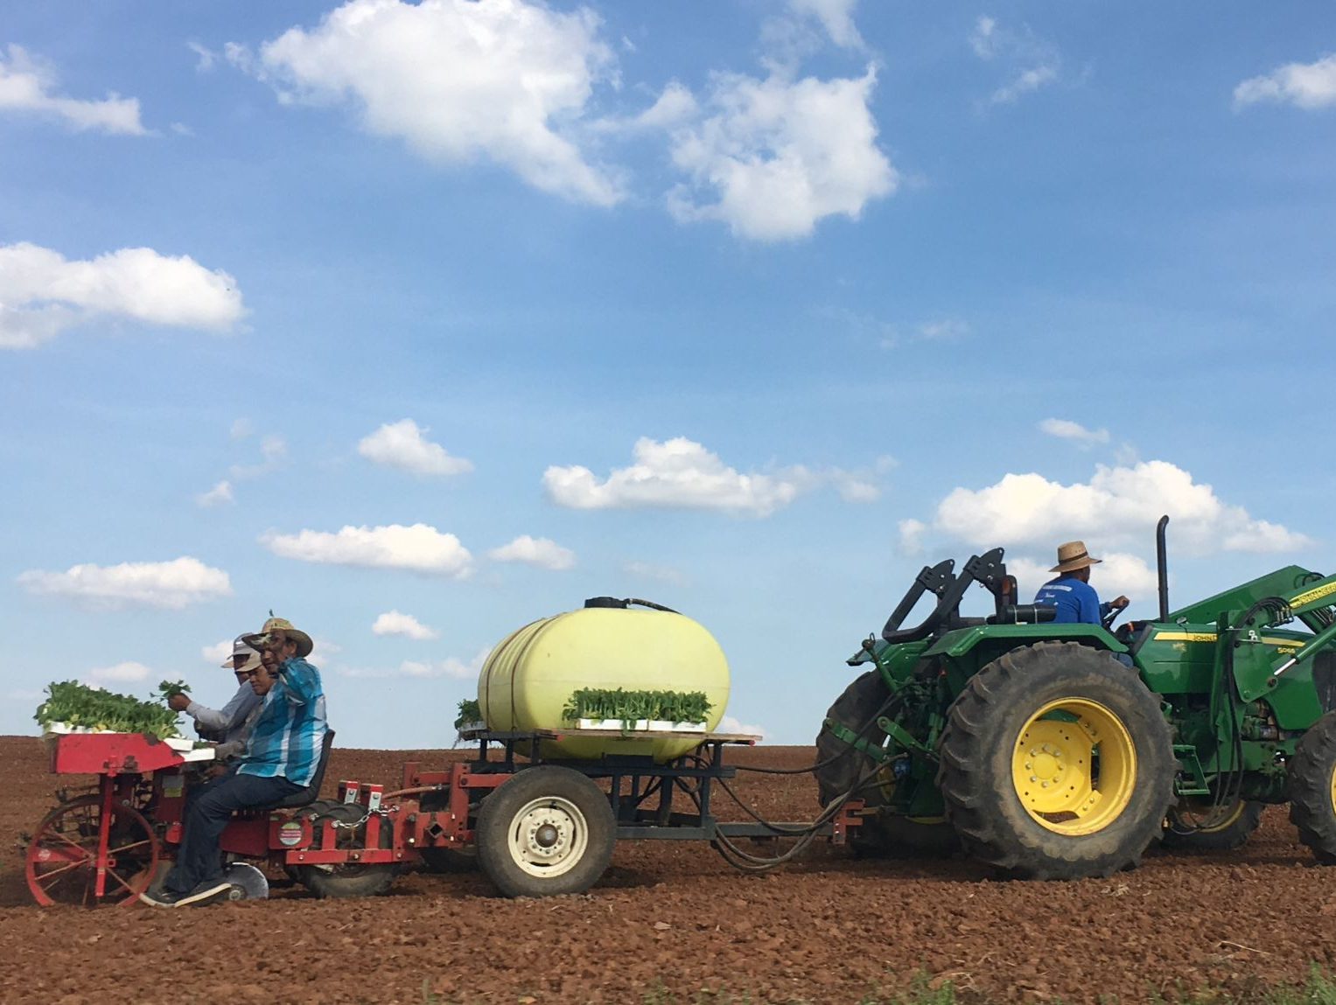
What Recruiters Should Expect
To spend long days in the field to take advantage of time in their assigned communities
Working in the field multiple days a week
Driving to and from destinations
Visiting a variety of locations including farms, processing plants, housing sites and more
Some days may require meeting workers early in the morning or late at night
Expect the unexpected!

Slide 8
What I Wish I Knew!
Don’t keep to yourself what you have learned.
Research about what the programs does and the impact that has done with the students.
Ask my supervisor to share more Recruiter’s Role and Responsibilities.
Learn to understand what a 'migrant lifestyle' is.
Olivia from Oregon

Slide 9
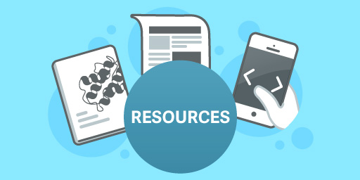
What Resources are Available to Recruiters?
There are a lot of resources available to recruiters that will help them learn more about what it means to be a recruiter and how they can be successful.

Slide 10
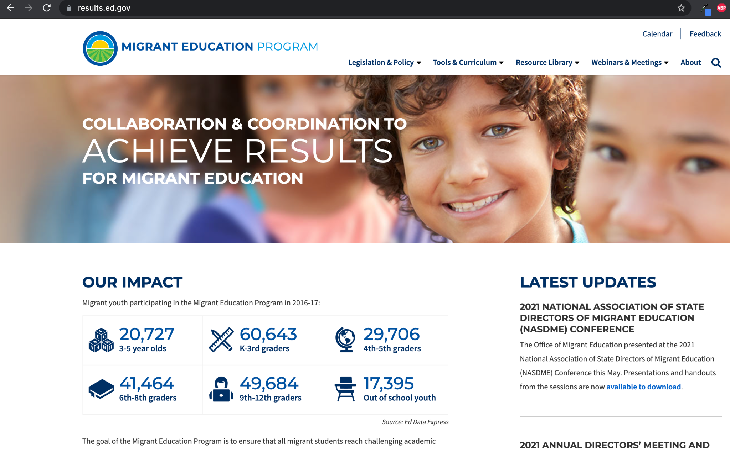
What Resources are Available to Recruiters?
Results.ed.gov is the official website of the Federal Office of Migrant Education (OME).
https://results.ed.gov/
Notes:
I will do a live demonstration of the Results.ed.gov website and demonstrate all the important things recruiters can find on the site

Slide 11
What Resources are Available to Recruiters?
All important legislation related to the Migrant Education Program can be found on Results.ed.gov
https://results.ed.gov/
Notes:
I will do a live demonstration of the Results.ed.gov website and demonstrate all the important things recruiters can find on the site

Slide 12
What Resources are Available to Recruiters?
All important legislation related to the Migrant Education Program can be found on Results.ed.gov
You can view the laws and regulations that govern MEP.
https://results.ed.gov/
Notes:
I will do a live demonstration of the Results.ed.gov website and demonstrate all the important things recruiters can find on the site

Slide 13
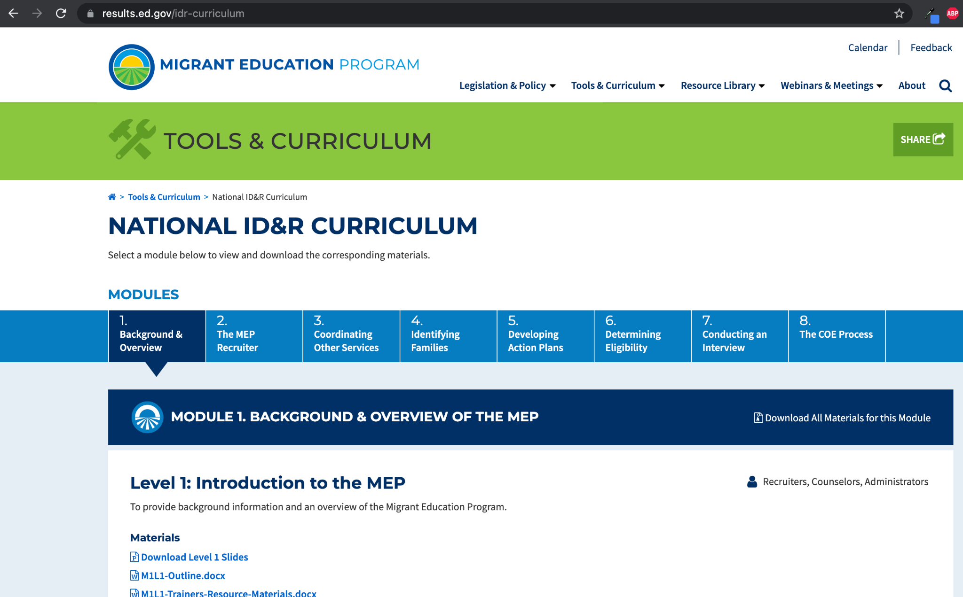
What Resources are Available to Recruiters?
Results.ed.gov also contains the free National ID&R manual and ID&R training curriculum developed by OME to help ensure recruiters are effective in their ID&R efforts.
https://results.ed.gov/idr-curriculum
Notes:
I will do a live demonstration of the Results.ed.gov website and demonstrate all the important things recruiters can find on the site

Slide 14
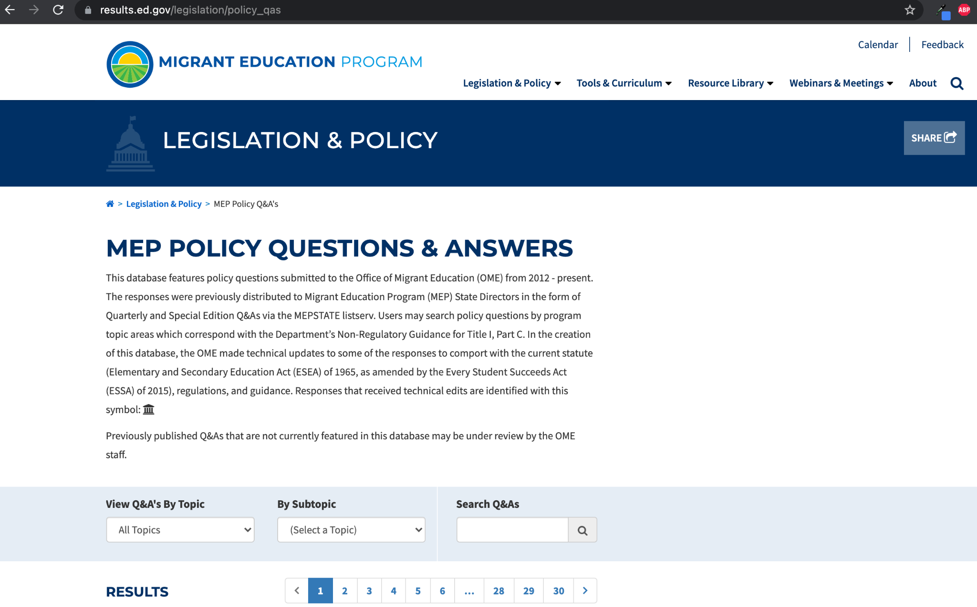
What Resources are Available to Recruiters?
Results.ed.gov features a regularly updated Policy Questions and Answers page that serves as additional information to help recruiters clarify any issues they may have in identifying potential students.
https://results.ed.gov/legislation/policy_qas
Notes:
I will do a live demonstration of the Results.ed.gov website and demonstrate all the important things recruiters can find on the site

Slide 15

What Resources are Available to Recruiters?
The Non-Regulatory Guidance, or NRG, is the recruiting rule book. The NRG is produced by the Federal Office of Migrant Education and features all the regulations that govern MEP.
https://results.ed.gov/legislation
Notes:
I will open up a copy of the guidance and demonstrate how it should be used

Slide 16
What Resources are Available to Recruiters?
Chapters 2 and 3 are the most important chapters in the NRG for recruiters because they cover eligibility rules and what it means to identify and recruit new students.
https://results.ed.gov/legislation

Slide 17
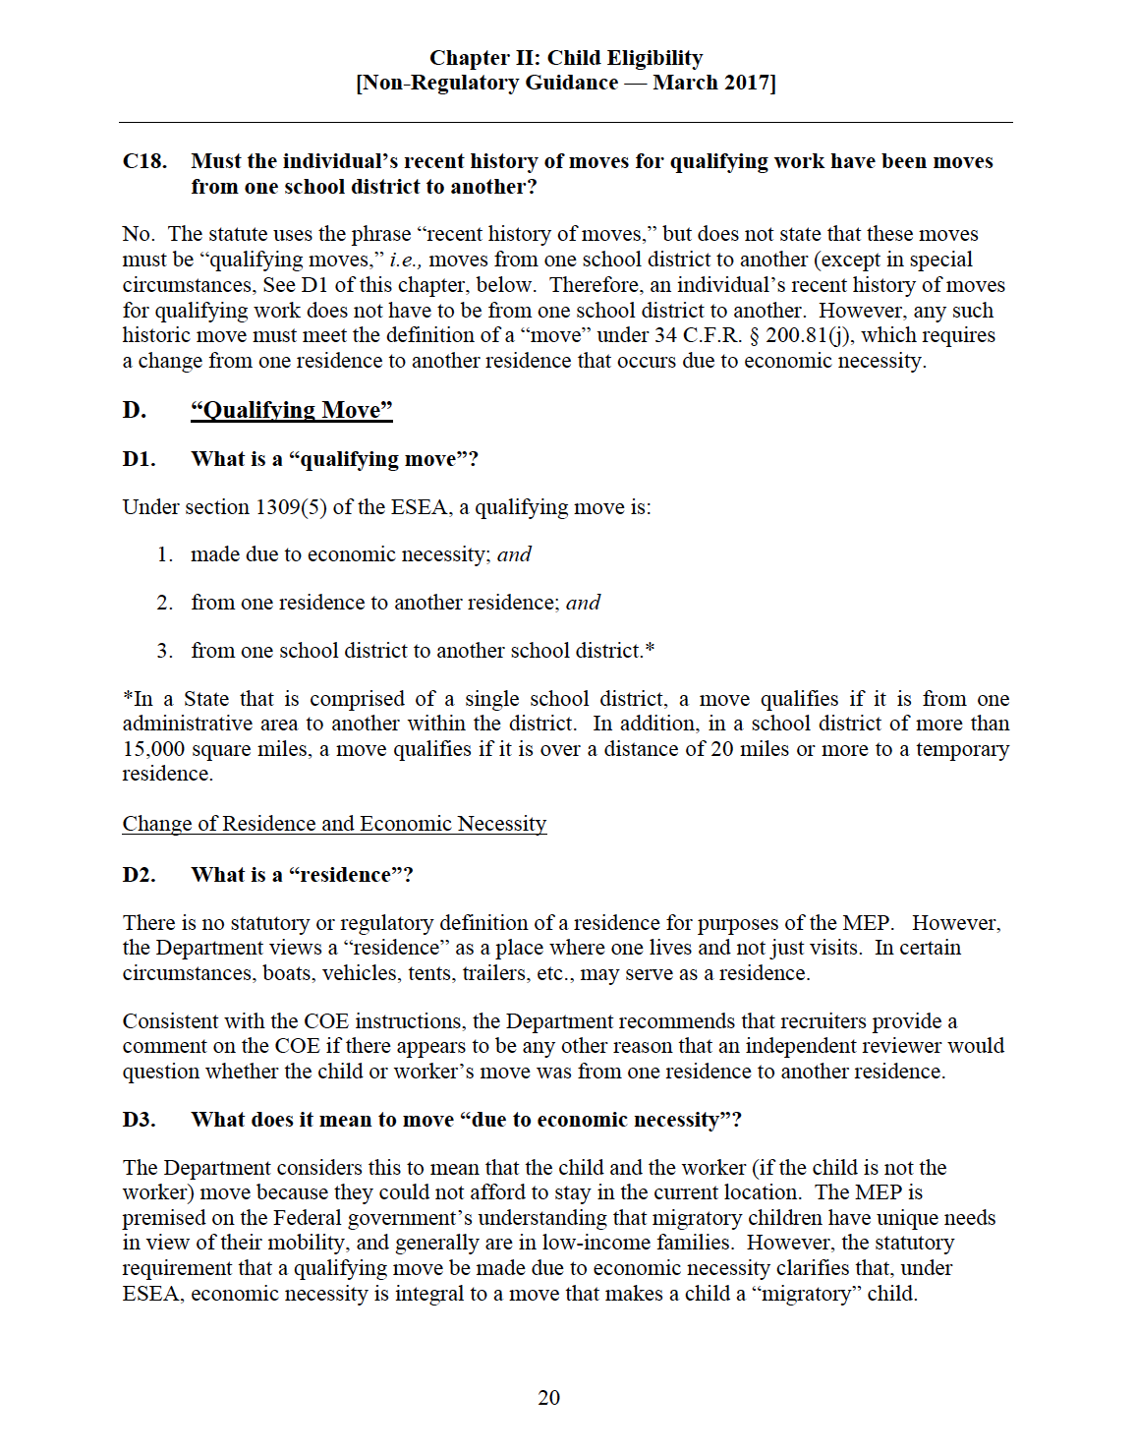
What Resources are Available to Recruiters?
The NRG may appear intimidating, but it is very simple to use.
Each chapter in the NRG is divided into topics and each topic has a series of questions to help you understand the finer points of each topic.
https://results.ed.gov/legislation

Slide 18
How to Use the NRG
When you are unsure if a student is eligible or have a question about eligibility, search for the related topic in the NRG.
Read carefully through each question in the related topic and apply the given rules.
https://results.ed.gov/legislation
Notes:
One this slide I will give a demonstration and show what to do if you are unsure about a specific qualifying activity

Slide 19
How to Use the NRG
For example:
You are out recruiting and encounter a migrant worker who works cleaning conveyor belts in a lettuce packing house. You are not sure if the activity counts as a qualifying activity for the purposes of eligibility.
What do you do?
https://results.ed.gov/legislation
Notes:
One this slide I will give a demonstration and show what to do if you are unsure about a specific qualifying activity

Slide 20
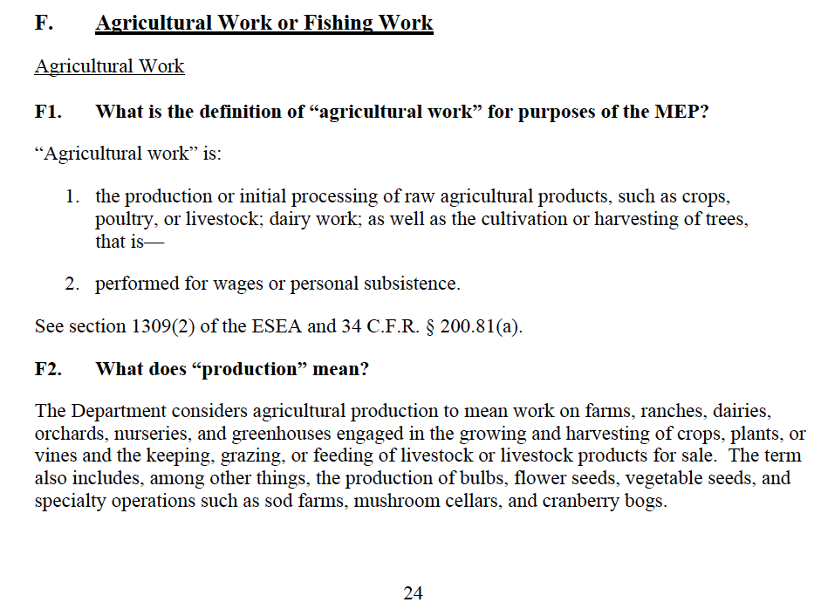
How to Use the NRG
You are trying to determine if cleaning conveyor belts at a lettuce packinghouse counts as a qualifying activity.
Look for the topic of Agricultural or Fishing Work on page 24 the NRG.
https://results.ed.gov/legislation
Notes:
One this slide I will give a demonstration and show what to do if you are unsure about a specific qualifying activity

Slide 21
How to Use the NRG
Based on question F1 we know agricultural work is work in the production or initial processing of raw agricultural products.
Read question F2 and ask yourself if cleaning conveyor belts falls under "production".
https://results.ed.gov/legislation
Notes:
One this slide I will give a demonstration and show what to do if you are unsure about a specific qualifying activity

Slide 22
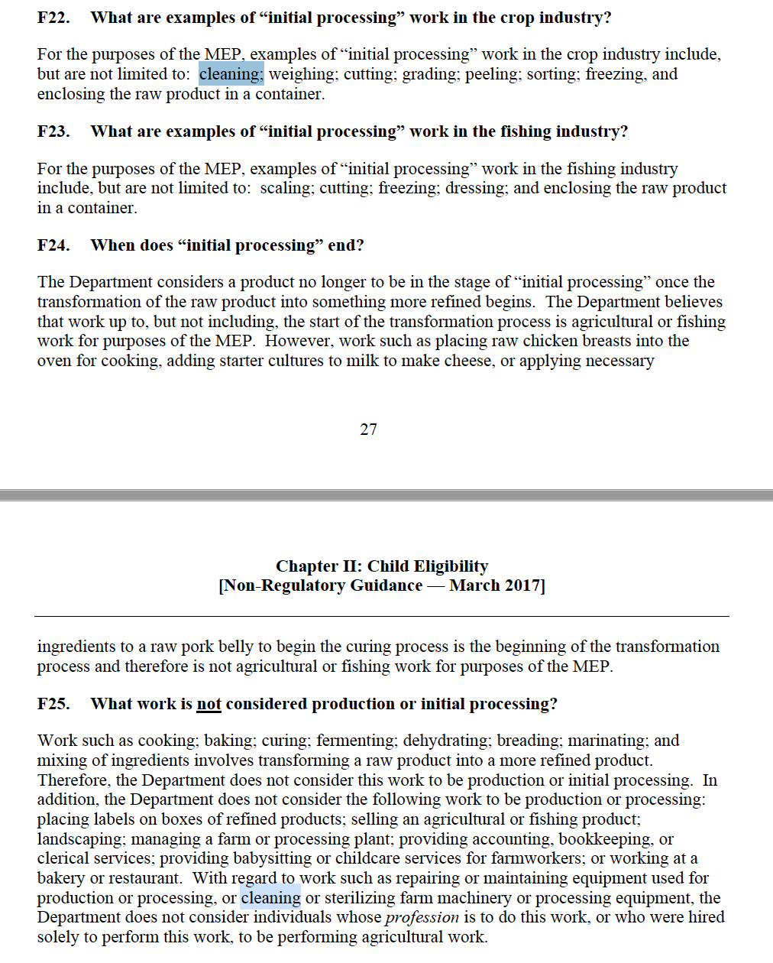
How to Use the NRG
Since we know cleaning conveyor belts does not count as a "production" we have to look and see if it can qualify under "initial processing."
There are several questions related to what does "initial processing" mean. Read questions F22-F25 in the NRG.
https://results.ed.gov/legislation
Notes:
One this slide I will give a demonstration and show what to do if you are unsure about a specific qualifying activity

Slide 23
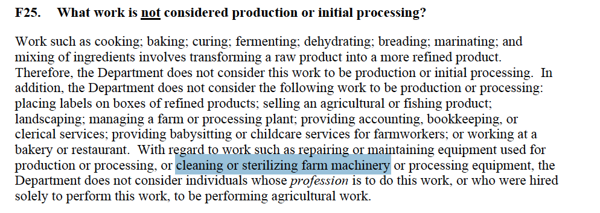
How to Use the NRG
Pay special attention to question F25. The question states that cleaning or sterilizing farm machinery does not count as "initial processing" of agricultural products.
https://results.ed.gov/legislation
Notes:
One this slide I will give a demonstration and show what to do if you are unsure about a specific qualifying activity

Slide 24
How to Use the NRG
Based on the information from the guidance in question F25, we can now confirm that cleaning conveyor belts at a lettuce packinghouse DOES NOT count as a qualifying activity because it does not meet the requirements to be considered "initial processing" of raw agricultural products.
https://results.ed.gov/legislation
Notes:
One this slide I will give a demonstration and show what to do if you are unsure about a specific qualifying activity

Slide 25
How to Use the NRG
IMPORTANT TIP
It is important to remember that many times workers on farms may perform multiple jobs/tasks.
If you encounter a worker at an agribusiness who performs a task that does not qualify, always check to see what other jobs/tasks they performed within 60 days of moving. They may be eligible for MEP from a different qualifying activity.
https://results.ed.gov/legislation
Notes:
One this slide I will give a demonstration and show what to do if you are unsure about a specific qualifying activity

Slide 26
What I Wish I Knew!
"Don’t worry too much! All this information feels overwhelming but with practice everything will make sense. Learn as much as possible from “the books” but concentrate mainly on talking to families in a comfortable way and relax while doing it so families will also feel comfortable and open up."
Yeni from Missouri

Slide 27

What to Look for in the Field
Recruiters have to be detectives in the field.
Recruiters should always keep their eyes open in the field and look for evidence of possible migrant farm workers or new farms. Experienced recruiters are always looking for signs of where migrant families could be working and living.

Slide 28
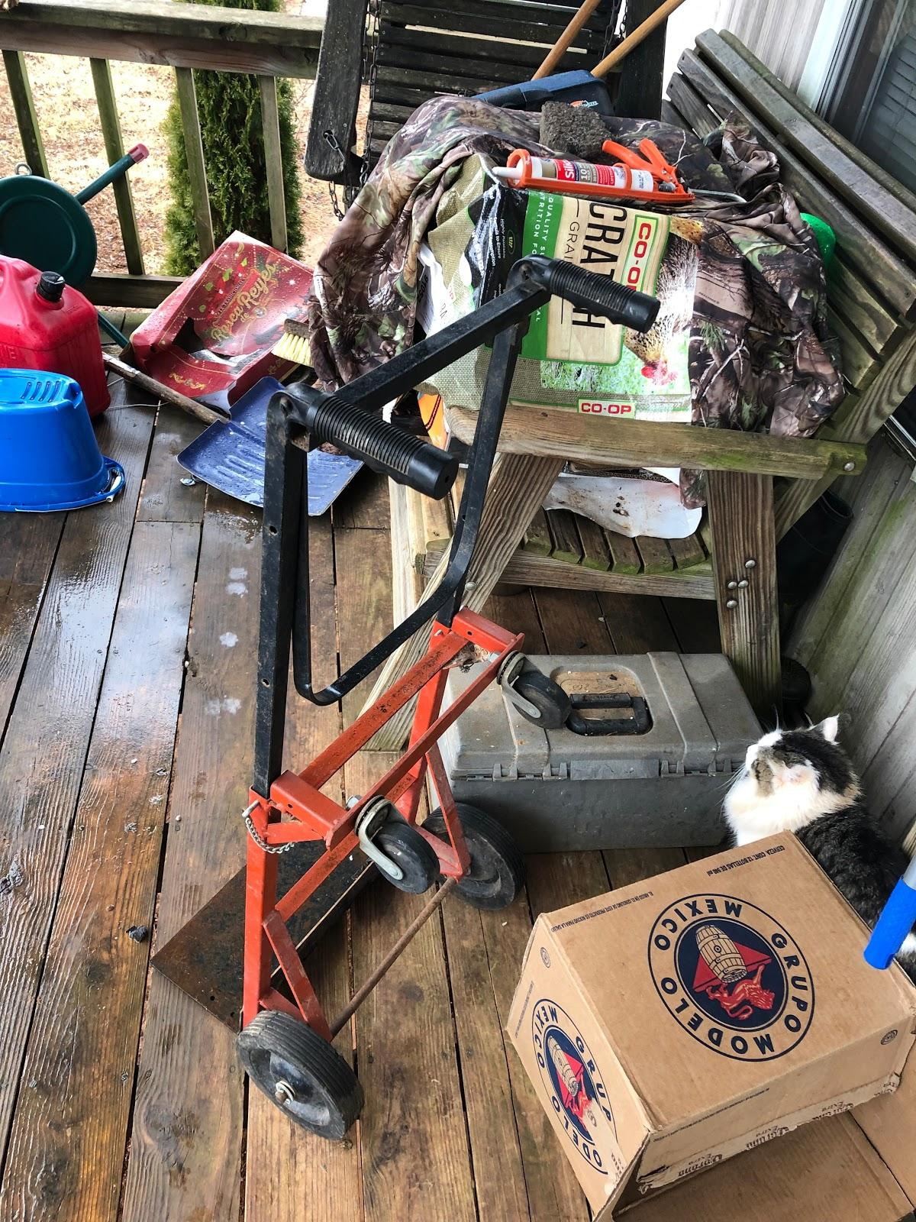
What to Look for in the Field
/
Recruiters should always be on the lookout for:
Agricultural Equipment/Boxes on porch.
Out of state license plates
Foreign language boxes or packages on porch or in trash.
Trailers or housing near farm site
White work vans with muddy tires
Farm vehicles
Example photo of the porch of a Migrant Family

Slide 29
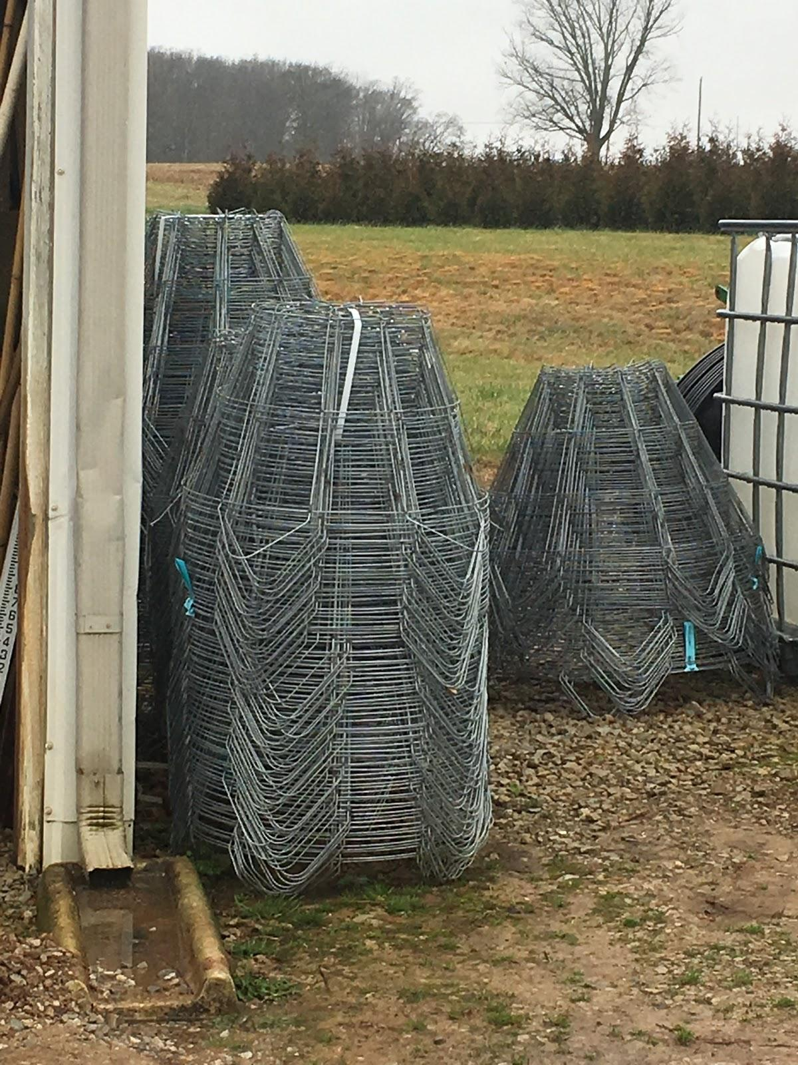
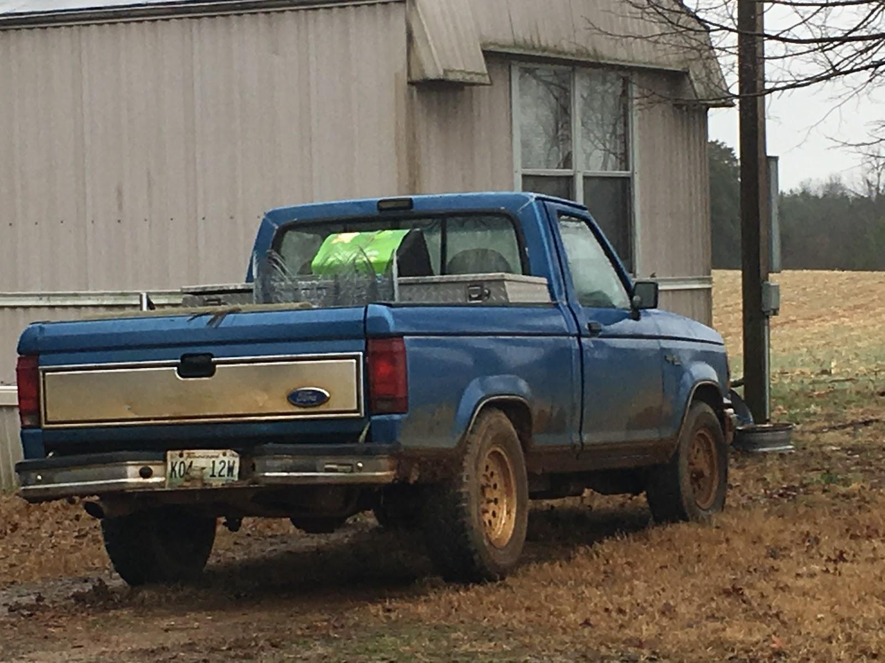
Baskets used at tree nurseries to help hold and transplant trees
Example photos demonstrating how farm equipment can be used to identify houses of potential migrant families/students

Slide 30

Conducting an Eligibility Interview
One of the key skills that all recruiters must learn is how to properly conduct an eligibility interview to see if migrant families/students qualify.
Recruiters will be conducting multiple eligibility interviews every day on the job.

Slide 31
Conducting an Eligibility Interview
It can take time and practice to become great at conducting eligibility interviews. Don't get frustrated with yourself and keep trying.
New recruiters may be helped by carrying COEs with them in the field to remind themselves of what information they need to obtain during eligibility interviews.

Slide 32

Tips for Conducting an Eligibility Interview
You don't have to jump straight into eligibility questions
Begin by making the conversation personal and checking how the family/student is doing
Always work to ask questions that will move the conversation forward
If something makes the person you are interviewing uncomfortable, change the subject and circle back around to it
You may have to ask some questions multiple times and in multiple ways to get an answer

Slide 33
Tips for Conducting an Eligibility Interview
Quality of time is more important than the quantity of conversations
Don’t immediately start with your elevator pitch unless prompted
Be careful of “danger words” that people may react negatively too
Always carry some form of identification that you can show if needed
During conversations stress connections with the local schools and department of education to help build trust
Always be respectful of their time

Slide 34
What I Wish I Knew!
"After being a Migrant Recruiter for a little over a year, the most reliable information that I would tell myself back when I first started is to build good rapport with your farmers, migrant families, schools, OSY’s, and anyone in one's region. Having good rapport is extremely important."
Iris from Missouri

Slide 35
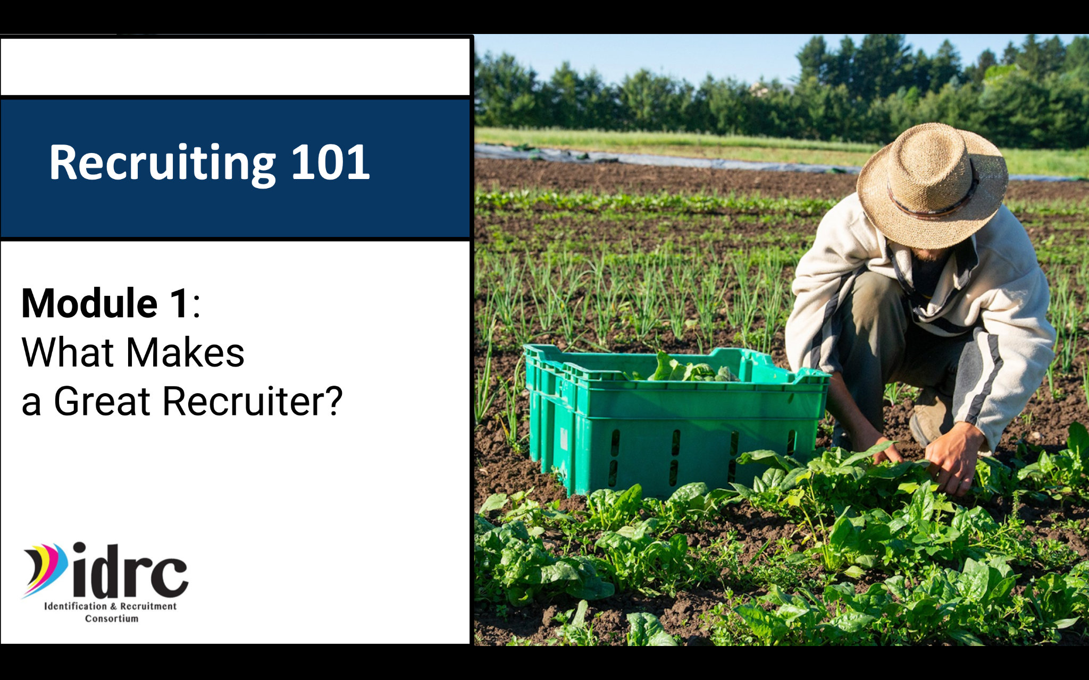
Recruiting 101 Module
Introducing the New
Recruiting 101 Module!
To help prepare new recruiters for working in the field, IDRC has created a new Online Training Module aimed at teaching new recruiters what they need to know to get into the field and recruiting.
Notes:
I will show a demo of the Recruiting 101 Module and workbook

Slide 36
Recruiting 101 Module
The Recruiting 101 module is a series of 7 lessons designed to be used by recruiters for self-study so they can learn individually and at their own pace.
Each chapter is designed to be completed in 30 minutes or less.

Slide 37
Recruiting 101 Module
The Recruiting 101 module is divided into 7 different lessons. Each lesson covers an important aspect of being a recruiter.

Slide 38
Recruiting 101 Module
Recruiting 101 Chapters:
What it Takes to be a Great Recruiter
Resources Available to Recruiters
The Migratory Agricultural Worker
The Qualifying Move
Getting Familiar With the COE
Getting Out Into the Field
After Being in the Field

Slide 39
Recruiting 101 Module
Each chapter of Recruiting 101 comes with a workbook to help guide your learning. The workbook includes:
Learning objectives for each chapter
Resources for further learning
Questions to help facilitate learning and self reflection
An activity to put what you have learned into practice
A mini-quiz to help evaluate learning

Slide 40
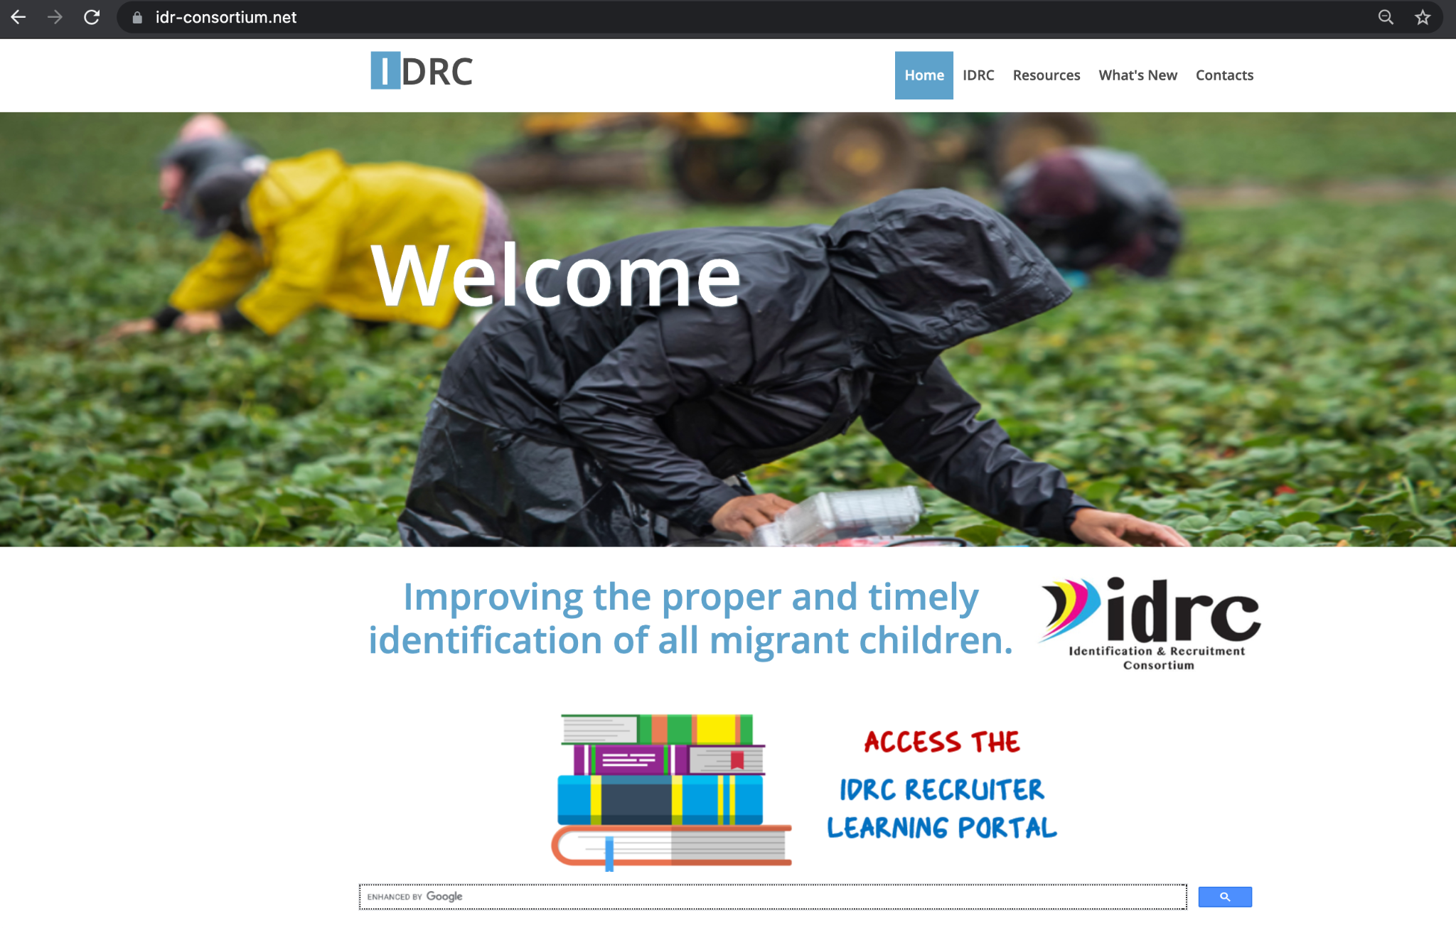
The IDRC Training Portal
The new IDRC Learning Portal is a terrific platform to help new and experienced recruiters learn and continue growing on the job.
The IDRC Learning Portal features dozens of online webinars and resources available for free viewing at any time.
https://www.idr-consortium.net/Portal.html
Notes:
I will take people to the IDRC Learning portal and show them how to use it to find topics they want to learn about and how to get access to resouces

Slide 41
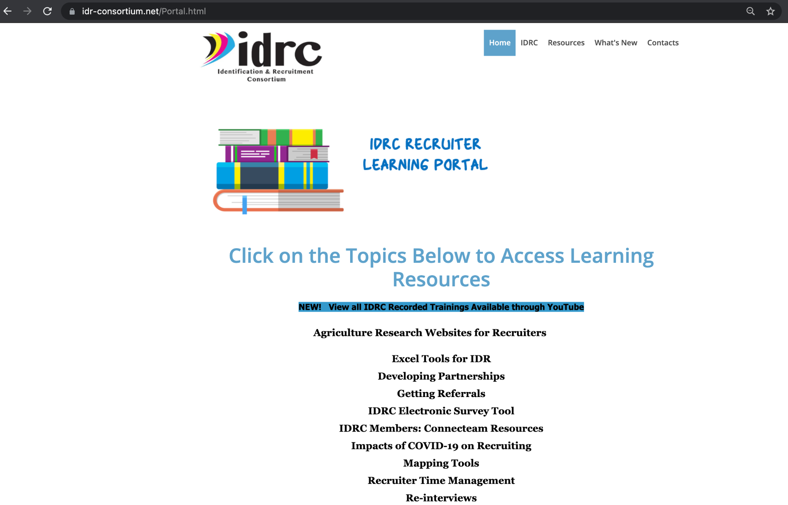
The IDRC Training Portal
All webinars and resources on the IDRC Learning Portal are divided by category to help make accessing them easier.
https://www.idr-consortium.net/Portal.html

Slide 42
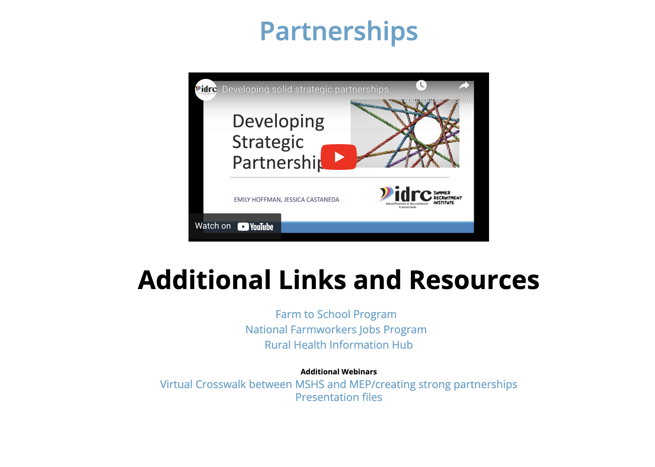
The IDRC Training Portal
Recruiters can freely explore each topic to learn more and see what resources are available to help them further their learning.
https://www.idr-consortium.net/Portal.html

Slide 43
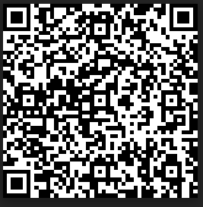
Training Review:
Please fill out the IDRC Training review form by using the link below or the scanning the QR code with the phone's camera
Training title:
Recruiting 101
https://www.surveymonkey.com/r/IDRCStaffTrainingEval20-21

Slide 44


Contact Info
Jessica Castañeda
IDRC Director
931-668-4129- office
931-273-4050- cell
jcastanedaidr@gmail.com
www.idr-consortium.net
Justyn Settles
IDRC Project Specialist
859-361-2239- cell
justynidr@gmail.com
www.idr-consortium.net

